Slide 1

Appointment Booking: A New Era for Nigerian Businesses
In the dynamic Nigerian business landscape, appointment booking is becoming increasingly vital for success. This presentation explores the rising importance of appointment booking across various sectors in Nigeria.
By Dare Halimat

Slide 2
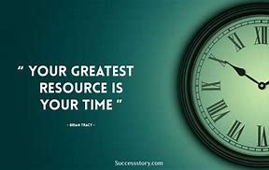
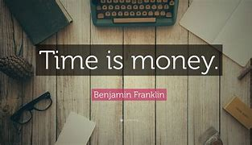
Quote by Brian Tracy
Quote by Benjamin Franklin

Slide 3
What is Appointment Booking
Appointment is a formal arrangement to meet or visit someone or a place at a particular time and place.
An appointment scheduling system or App is a tool that streamlines the booking process for businesses, organizations, or individuals. It eliminates the need for phone calls or in-person visits and allows users to schedule appointments through a web interface or mobile app.
In todays fast-paced digital world, appointment booking apps have become an essential tool for businesses and service providers.

Slide 4
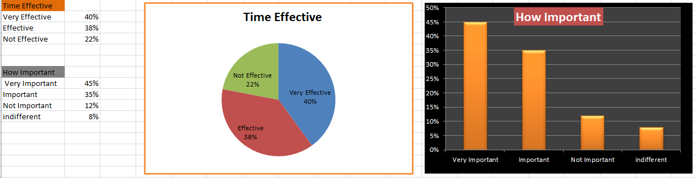
Survey
I asked few Nigerians how they will like to work with Appointment booking for most of their visits to Business organizations ranging form Doctors office, Bank activities, Saloon and Spa, Dentist, Auto Shop and more.
The few question that was asked was how Important they feel booking an appointment before their visit to a business organization is?, How it will effectively save time, Preference for booking appointment and the Economic Impact and I got about 127 responses.
I cleaned the raw data from excel and used some few chart designs to visualize the responses that I got.

Slide 5
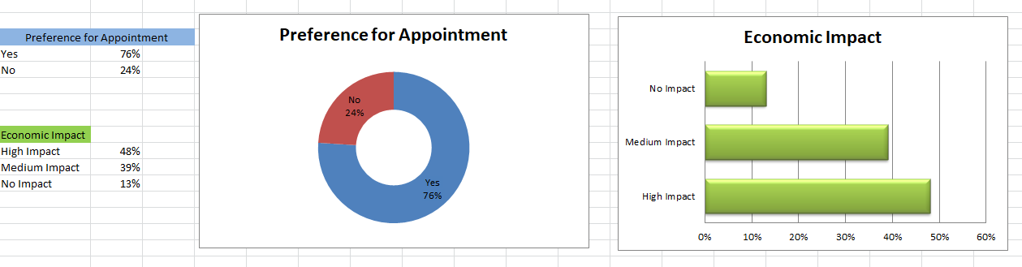

Slide 6
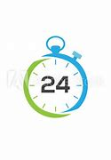
After carefully reviewing my reponses on the Importance of Appointment booking, this brings about the business Aspect of it and solution I will like to proffer and that is developing appointment booking App that can easily connect business owners and Customers , just like Glovo, Chowdeck and other food apps connect food vendors to their customers.
In the USA There are a lot of appointment booking APPS, like SimplyBookme, Timely, Bookafy, Calenderhero, EngageBay and many more.
While this can App can Generate money for its Developer as Business owners will have to pay/Subscribe to partner with them.

Slide 7

Benefits of Appointment Booking for Customers
1
Convenience and Flexibility
2
Reduced Waiting Times
Appointment booking systems help businesses manage their schedules efficiently, minimizing wait times for customers.
Customers can book appointments at their convenience, 24/7, from anywhere with an internet connection.
3
Improved Service Quality
4
Enhanced Communication
Businesses can dedicate focused attention to each customer, leading to a more personalized and satisfying experience.
Appointment booking systems provide a platform for clear and consistent communication between businesses and customers.

Slide 8




Other Benefits
Improved Customer Experience
Appointment booking empowers businesses to provide a seamless and positive customer experience, fostering loyalty.
Personalized Service
Increased Retention
Appointment booking allows businesses to tailor services to individual customer needs, enhancing satisfaction.
Satisfied customers are more likely to return for future appointments, contributing to business growth.

Slide 9

Competitive Advantage in the Nigerian Market
Increased Visibility
Businesses can reach a wider audience through online booking platforms.
Enhanced Efficiency
Appointment booking streamlines operations, allowing businesses to compete effectively in a fast-paced market.
Improved Customer Experience
By offering a convenient and seamless booking process, businesses can stand out from competitors.

Slide 10




Challenges and Considerations for Businesses
Technology Adoption
Implementing appointment booking systems requires businesses to adopt new technology and train staff.
Security and Data Privacy
Businesses must ensure the security of sensitive customer data collected through booking systems.
Integration with Existing Systems
Businesses need to integrate appointment booking systems with their existing CRM and other software to ensure seamless operations.

Slide 11

Conclusion: ~The Strength of a nation derives from the integrity of its workplace~ by Nathaniel Hawthorne
Appointment booking is rapidly becoming an integral part of the Nigerian business landscape. As technology continues to evolve, businesses must embrace appointment booking to enhance efficiency, improve customer satisfaction, and gain a competitive edge in the market.

Slide 12


